Slide 1
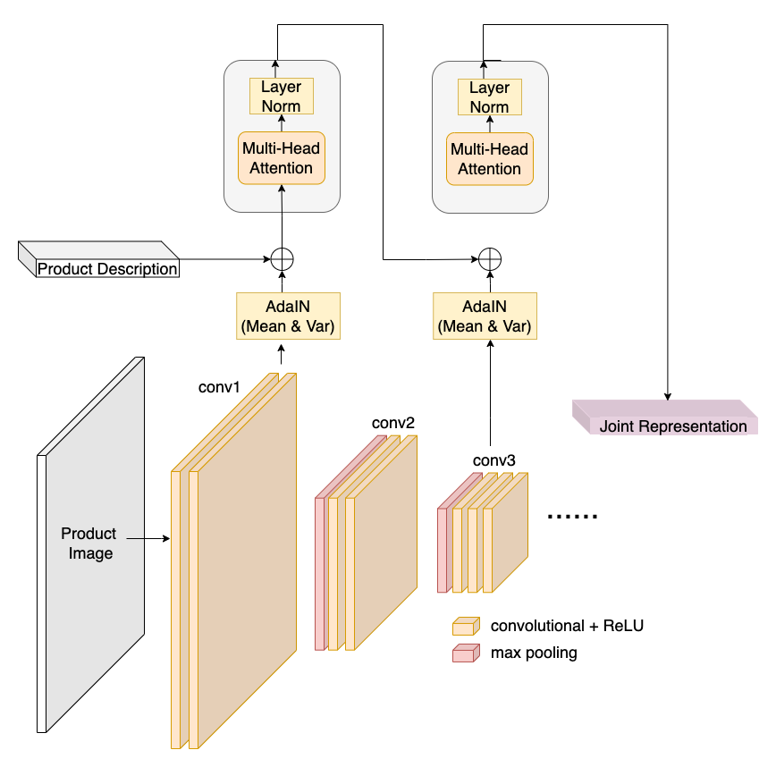
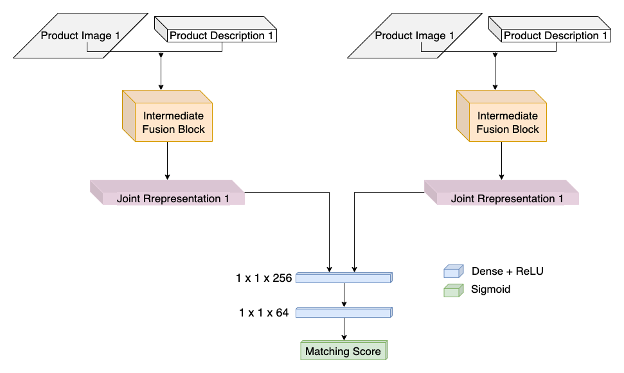
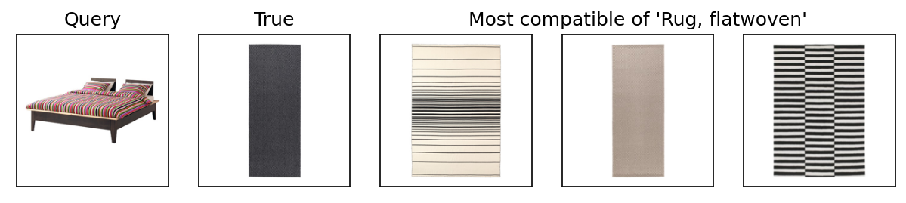
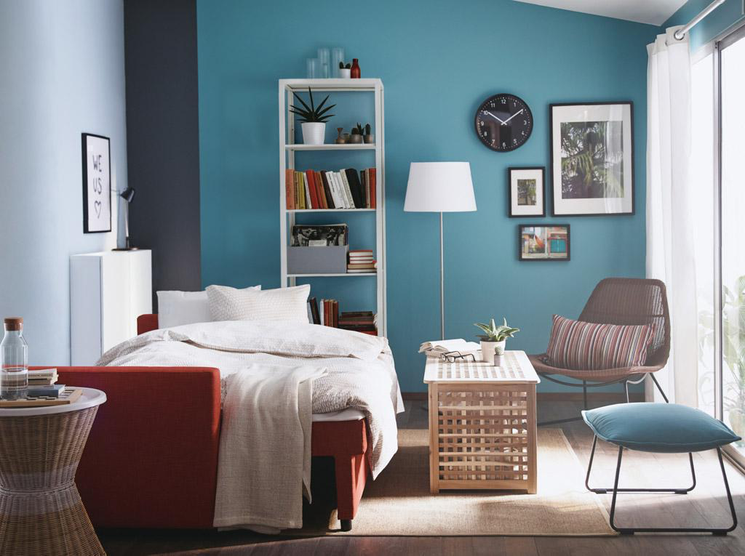
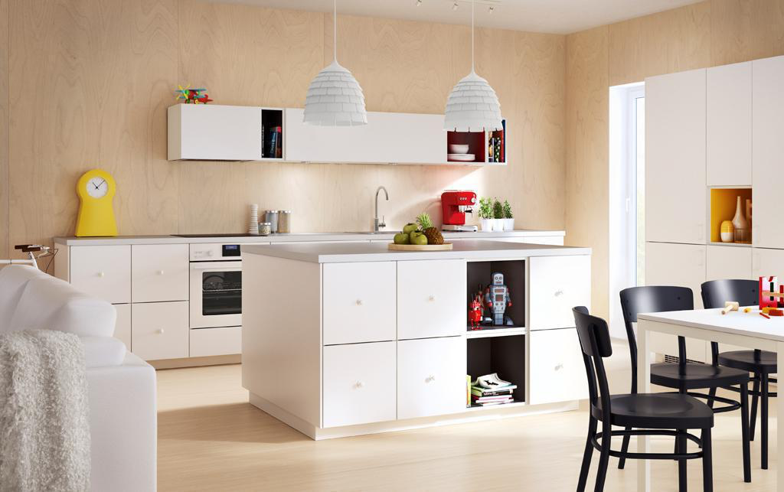
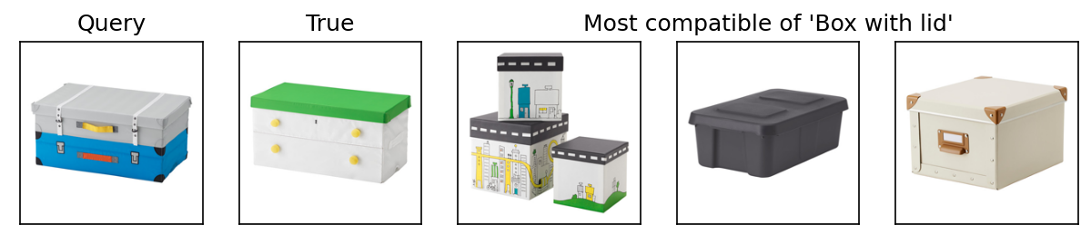
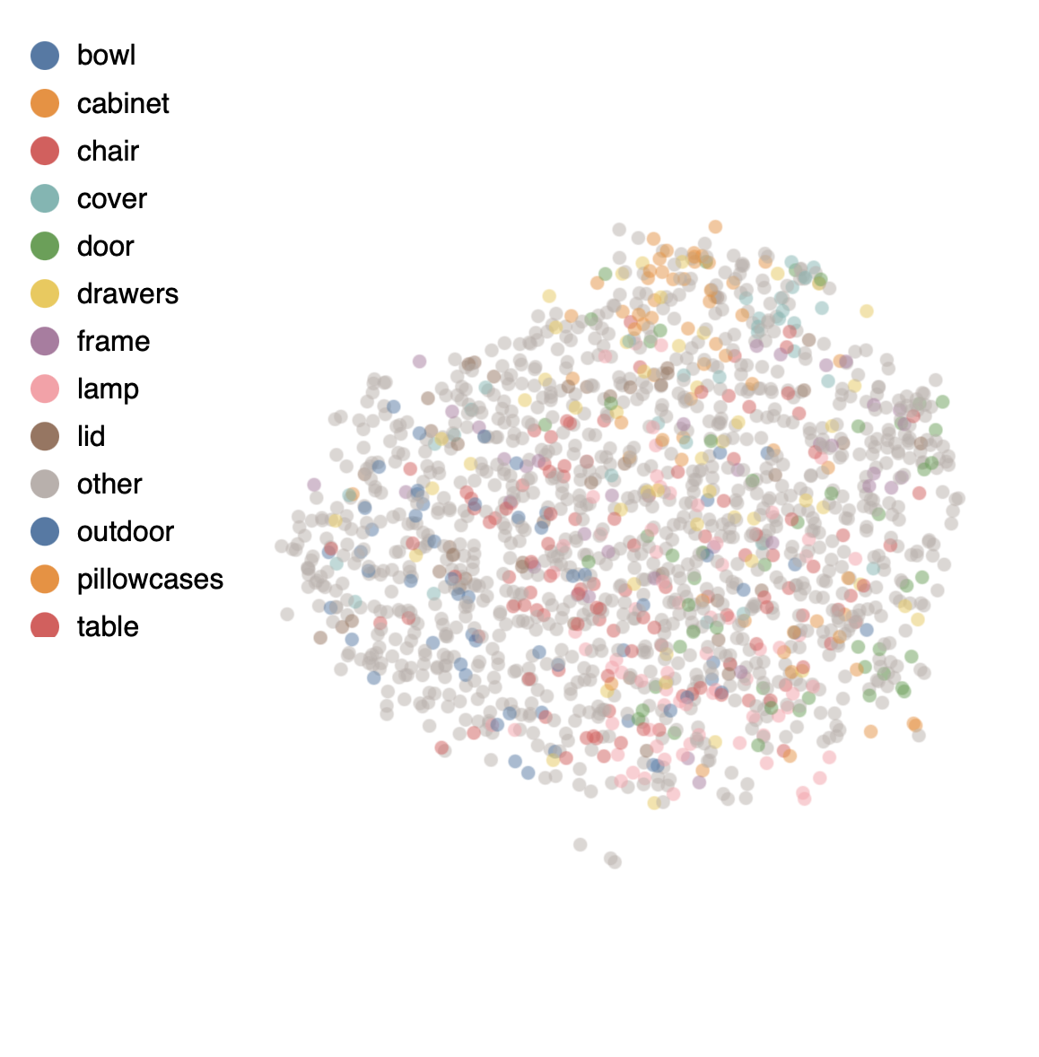
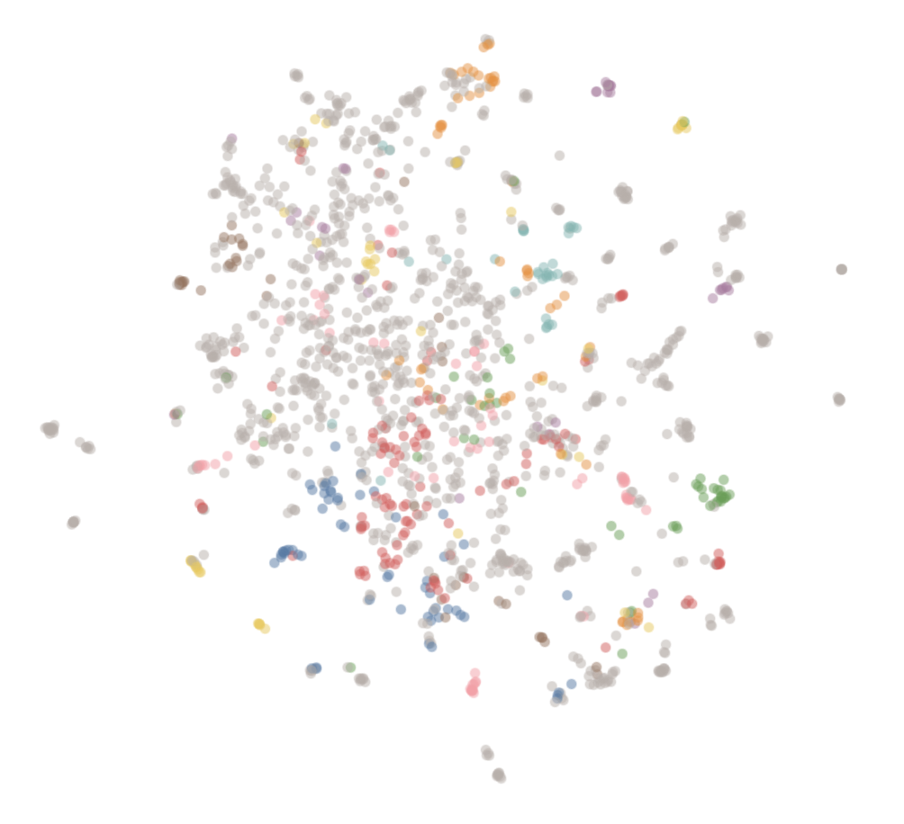
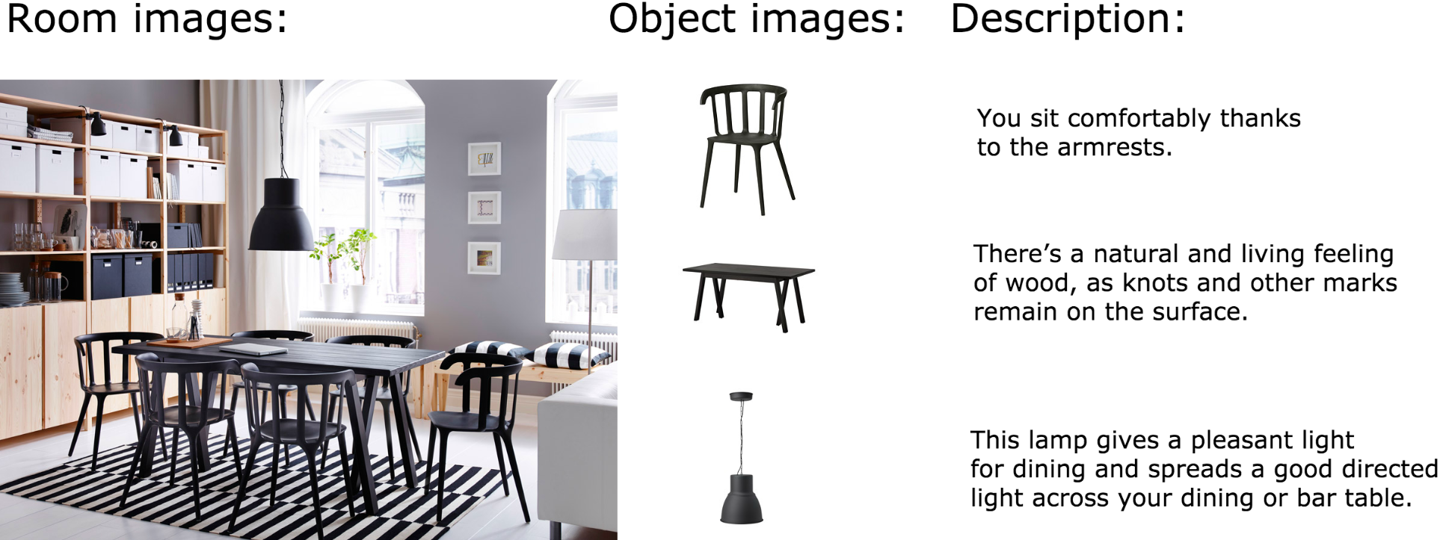
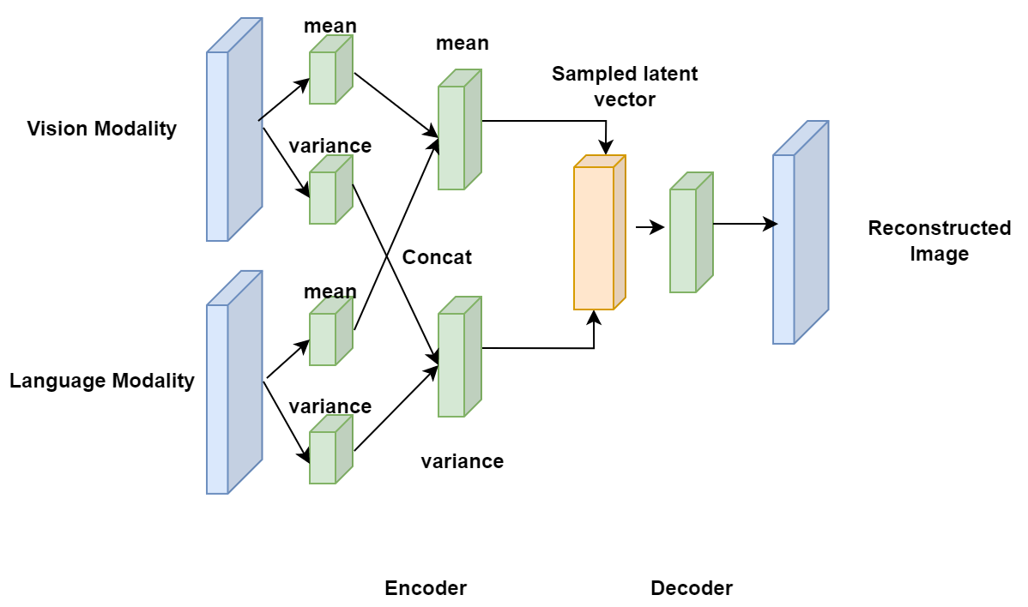
Décor: Multimodal Retrieval for Interior Design
Haocheng Han, Yuanxin Wang, Yiting Feng
Motivation
The current popularity of e-commerce motivates intelligent ways to help surface stylistically compatible products to customers.
However, most existing machine learning approaches have not directly addressed style (e.g., visual similarity) or have addressed style in terms of subjective categories (e.g., industrial, modern).
In this work, we investigate the task of learning style compatibility in a self-supervised manner by leveraging IKEA furniture placed in the context of designer-curated showrooms.
Proposed Approaches
Experiments
Intermediate Fusion
Use mean and variance of each Conv output as the start token for transformer instead of using the output of VGG-16 (similar to StyleGAN)
 | Naive CLIP | Fine-tuned CLIP | Intermediate fusion (single) | Intermediate fusion (ensemble) | Multimodal VAE
Validation Accuracy | 0.549 | 0.661 | 0.580 | 0.583 | 0.484
AUC | 0.559 | 0.742 | 0.604 | 0.611 | 0.456
NDCG@5 | 0.0028 | 0.1078 | 0.0070 | 0.0092 | 0.0085
Single query recall@5 | 0.364 | 0.505 | 0.357 | 0.391 | 0.382
Double query recall@5 | 0.372 | 0.506 | 0.371 | 0.388 | 0.394
Figure: Overview Architecture of Intermediate Fusion
Ranking Examples
Query text: Bed frame - The angled headboard allows you to sit comfortably when reading in bed.
Query text: Trunk for toys - Looks like a suitcase, perfect for everything needed when it’s time to go on an adventure at home.
Figure: Implementation Details of Intermediate Fusion Block
Dataset
2,193 object (product) photos and text descriptions.
298 context (room scene) photos in which those objects appear.
Multimodal VAE
Use both vision and language modalities to train a VAE that reconstructs the original image.
Use trained VAE as the encoder and take the bottleneck features as the “style” representation for each furniture.
Train a simple binary classifier with fully-connected layers using the representations.
Embedding Visualizations (UMAP)
Multimodal VAE
Intermediate Fusion
Discussion
Fine-tuned CLIP gives the best results in terms of ranking, but intermediate fusion with Conv Layer Statistics and multimodal VAE improve on vanilla CLIP and produce realistic results
CLIP’s strong prior on functional similarity may give it a boost on ranking metrics
Future Work
Combine intermediate fusion with CLIP
Take a data-centric approach to toss out bad examples in the dataset and perform more data augmentation
Problem Statement
Given two furniture F₁ and F₂ as input, our objective is to determine whether they are compatible or incompatible y ∈ {0, 1}. As ground truth, we define two furniture as compatible if they co-occur within at least one of the rooms.
Our goal is to learn good representations of F₁ and F₂ and build a compatibility function C, which represents a distance measure between F₁ and F₂ ŷ = C (F₁, F₂).
Co-Learning with Room Images
Room images can be used as inputs instead of limited to self-supervised labels
Room images partially available in training, unavailable in testing (replace with mean/empty/noise image)
Notes:
1

